Slide 1
Community Resilience to Extreme Events
19th February 2019
University of Stirling

Slide 2
Extreme Events
Who we are and why we are here
February 19, 2019

Slide 3
Extreme Events in Science and Society
A transdisciplinary research programme with representatives from all academic faculties at Stirling united by common interest
We work to understand times of sudden and gradual change and unite around the concept of working with change rather than against it.
We seek to share understanding across research areas
Key Messages:
To bring people together
Blend disciplines and work together
To find solutions to challenges and key problems through interdisciplinary research
To find new approaches and combine methodologies to solve global problems.

Slide 4
Community Resilience to Extreme Events
Aims
Identify models of good practice in community resilience to extreme events that can inform approaches across policy, practice and research
Develop a network of expertise that links Scotland into international developments and good practice
Objectives
Engage in knowledge exchange between national/international experts from across disciplines and sectors, who have been involved/interested in working with communities in the context of resilience, community development and responses to extreme events
Provide scenarios from around the globe of community resilience practice to help us better understand how community resilience works, in what contexts and to encourage further community resilience good practice in the face of extreme events

Slide 5
Introduction: Agenda
09:30 – 10:00 | - | Arrival
10:00 – 10:35 | - | Welcome, introductions and ice breaker
10:35 – 11:00 | - | 1: What do we mean by extreme events?
11:00 – 12:00 | - | Keynote: Serge Marti
12:00 – 12:45 | - | Lunch
12:45 – 14:30 | - | 2: Communities and Community Resilience
14:30 – 15:00 | - | Break
15:00 – 15:50 | - | 3: What Next?
15:00 – 16:00 | - | Closing Remarks
16:00 | - | Workshop Closes

Slide 6
Introduction: Ground Rules
All voices equal
One voice at a time
Non-attributable
Mobile phones *silent*… but #CR2EE #StirExtreme
→ Ideas Board

Slide 7
What do we mean by extreme events?
Sudden, extreme changes that groups of people experience at any one time
Typical focus on weather or climatic events, and/or natural disasters such as storms, droughts, floods etc.
Typically thought of as negative
Extreme Events in Science and Society Research Programme is interested in a more open definition.
Maybe these extreme events can also include disease outbreaks, social uprising or events leading to a serious economic downturn
Aim is to unite around the concept of working with change rather than against it – how do we adapt and respond?

Slide 8
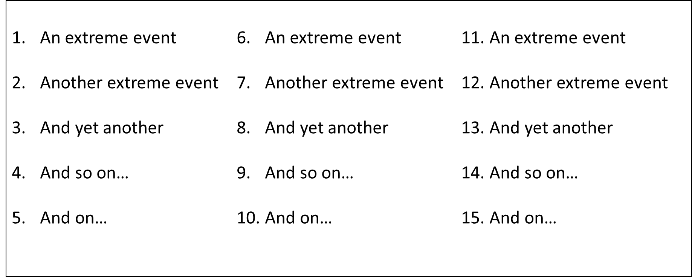
Session 1: Context – what do we mean by extreme events?
1. What are important extreme events?
2. What should we focus on?
What do you think?
Important (10)
Really
Important (5)
Core (2)

Slide 9
1. What are important extreme events? – whole room suggestions
Fire at Ocado (500m exclusion), St Andrews University fire
Clutha Helicopter Crash
Suicide event in public space
Flooding – Aberdeenshire – Storm Frank
Landslide – Rest and be thankful
Independence movement in Scotland
Closure of big employer – Honda factory
Black out power
Pandemic
Beast from the East / 2010 winter… preparation for snow
Depopulation in small communities / islands
Cyber threats
Sport mega-events – displacing people from homes
Changes to welfare system – sanctions
Race related violence
CNI – opening of Aberdeen bypass / M6 lanes
Terror attack
Localised power outage
Zoonotic diseases
Brexit
Water shortage – private supplies
Piper-alpha – offshore platform fire
Birth, bereavement, diagnosis

Slide 10
Session 1: Context – what do we mean by extreme events?
2. What should we focus on? (group work across 8 groups)
Important (10)
Really
Important (5)
Core (2)

Slide 19
2. What should we focus on? – ‘core’ results (2 per group)
Flooding (and extreme weather) x 7
Brexit (and ‘willed’ events or political events) x 5
Pandemic
Collapse in biodiversity
(Sport) Mega events
Economic events (closure of major employers)

Slide 20
Keynote Presentation
19th February 2019
University of Stirling

Slide 21
Community Control Builds Resilience
Serge Marti, LifeMosaic
Notes:
the intersection between global extreme events (climate change, ecosystem destruction, culture and language loss, etc.) and national/local extreme events (loneliness, depression, self-harm, etc.), relating these to disconnection from self, society, culture and land. He will then discuss examples of how to increase resilience and to tackle these issues in part by supporting the spread of community-led approaches, which allow communities to regain control over their lives, and can deliver powerful changes that ripple across society
Intro - me, LifeMosaic,
Thanks to Tony for inviting me
Thanks to all involved in the Extreme Events in Science and Society Research Programme

Slide 22
Building blocks
Systems Supporting Indigenous Resilience

Slide 23
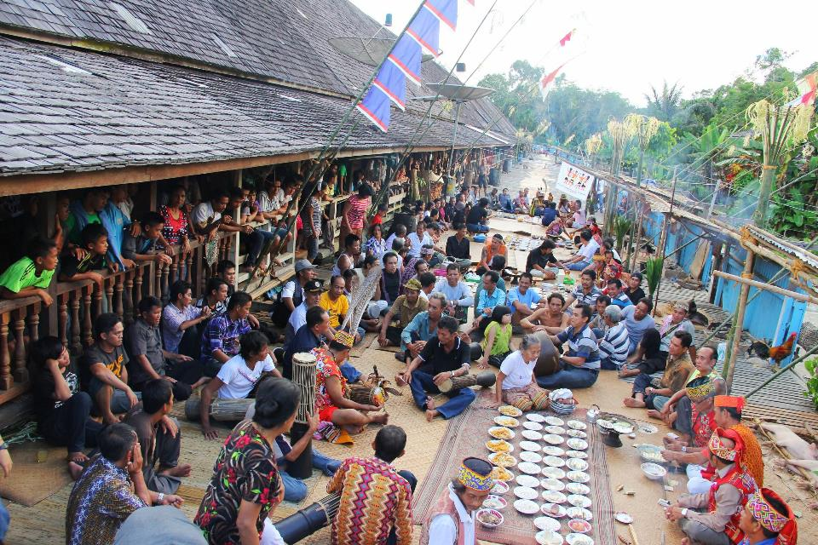
Notes:
PLACE:
Territory
Deep knowledge of place
Collective ownership of territory
Intact forests, rivers, and other ecosystems.
Access to land for farming, hunting, gathering.
Seed diversity
Crop diversity
Food security => food sovereignty.
Forest management.
Conservation.
PEOPLE AND CULTURE
Leadership and elderhood
Rituals
Kinship
Indigenous knowledge systems and practices
Language
Intergenerational learning
Customary law
Traditional health
Songs, storytelling, weaving, architecture, dance, crafts.
Philosophy
Rituals maintain equilibrium with nature and people. Rites of passage.
Knowledge systems and practices contain forms of resilience

Slide 24
Resilience Stories
Ability to find water, to move to marginal types of seed or crop, famine foods.
1999 Krismon – monetary crisis – indigenous peoples maintained resilience financially while others went to the wall.
Tsunami 2014: countless indigenous peoples (sea nomads in Thailand, Andaman and Nicobar islanders, were able to watch the waves and the animals and escape to high ground
Song about Tsunami, and early warning shout of Smong, smong in Simeulue (Aceh)
Earthquake in Lombok Aug 2018
Notes:
The Indonesian government has typically looked upon the traditional houses as “slum dwellings,” an indicator of poverty. But Lalu says the government should support the construction of traditional houses. Not only are they cheaper, but as the recent disasters proved, they are infinitely safer. traditional homes have been seen to mark the persistence of poverty rather than the preservation of culture, ignoring their instrumental value

Slide 25
Oil palm story
Nanga Taman, West Kalimantan

Slide 26
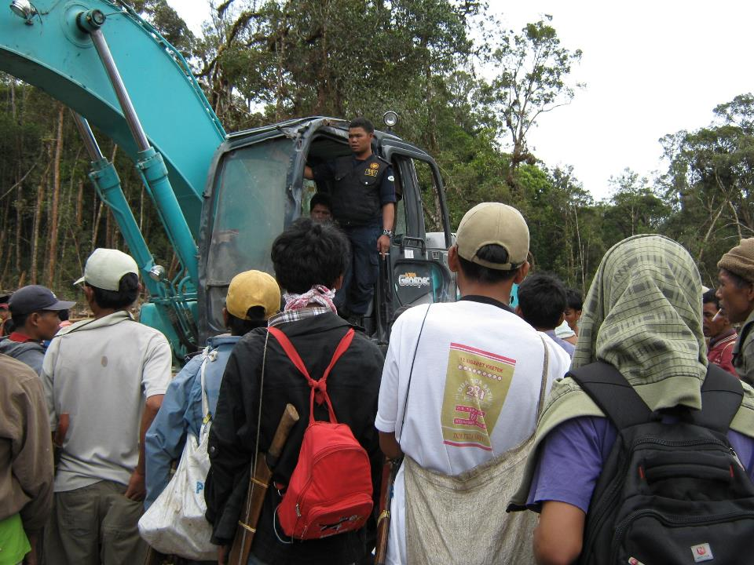
Notes:
History of land: Domeinsverklaring 1870 declared all land without clear documentation belonged to state.
At independence handed to Indonesia.
Zoned for development by developmentalist Suharto regime.
Community seen as invisible.
1. Bypass consultation.
First steps: destroy all signs of community connection to land.
Destroy forest gardens, destroy ancestors graves.
2. Consultation
Companies come with sociologists, anthropologists to convince people and gain support
Small groups ‘consulted’
False claims of support (false signatures)
3. False promises of development
Schools, water, roads, jobs.
4. Divide and Rule
Bribes to leaders: Food, houses
Find ways for village to fight
Buy plots of land to destroy collective ownership.

Slide 27
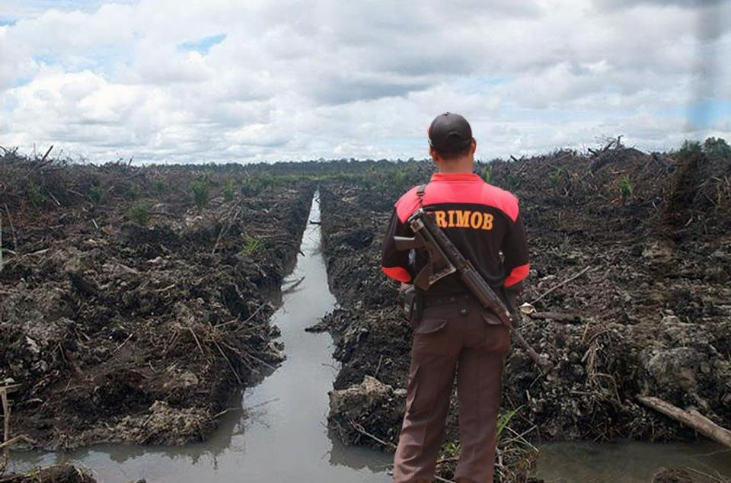
Notes:
5. Threats
False accusations, coercion, lawsuits
Imprisonment, killings
Forcible eviction of the local community, Dayaks, Papuans, Moluccans, Sumatrans
Indigenous peoples pulled into low-wage factory conditions on their land, often as indentured labourers.
Loss of cultural diversity
Intergenerational language loss
Corrupt leaders
Vast destruction of habitats
Loss of resilience
Loss of land.
We have experience of this with the clearances, loss of land, loss of knowledge, loss of culture (both Gaelic and Scots), Act of Proscription 1746, Education act 1872.
Vast destruction of habitats. [xxx million hectares of oil palm plnatations now]
India joins WTO, and Palm Oil is subsidized through access to cheap land (human rights abuses and ability to sell timber in natural forests), suicides among indian farmers.
Trade agreements, such as WTO, and government policies helped to lower vegetable oil prices…

Slide 28
Global Context

Slide 29
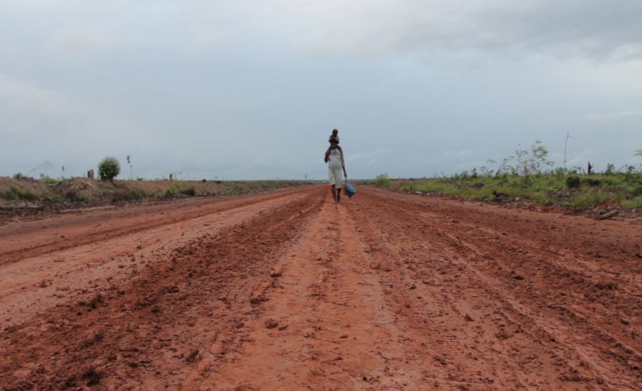
Global Resource Rush:
Global economy due to triple in size. World population will reach 9 billion in 2050. Maintaining resource-intensive life-styles in industrialised countries while developing countries move toward similar consumption levels.

Slide 30
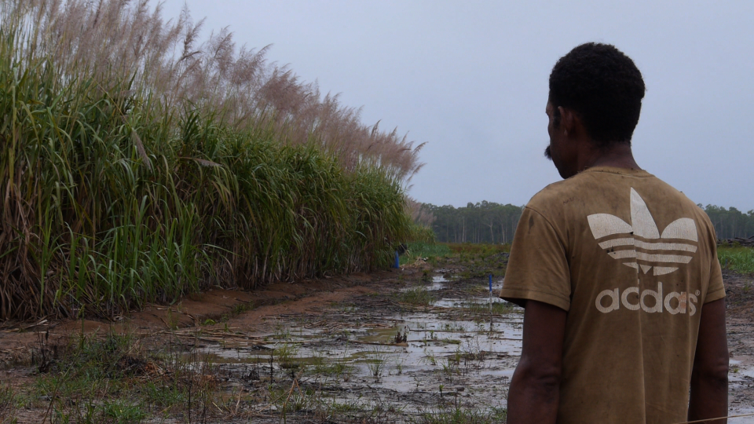
200 million hectares of land – the size of Western Europe – sold or leased in last 15 years, mostly to international investors.
Half of the land is in Africa - the new Scramble for Africa

Slide 31
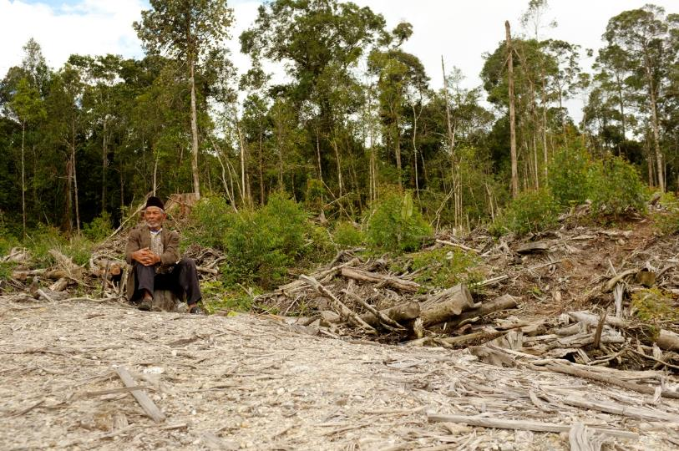
INDONESIAN LAND GRAB
By 2020:
14 million hectares oil palm plantations
9 million hectares new industrial tree plantations
2 million hectares forests conversion for mining

Slide 32
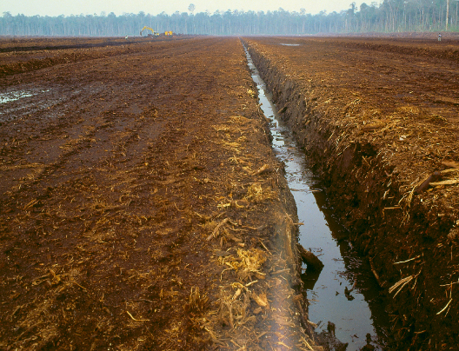
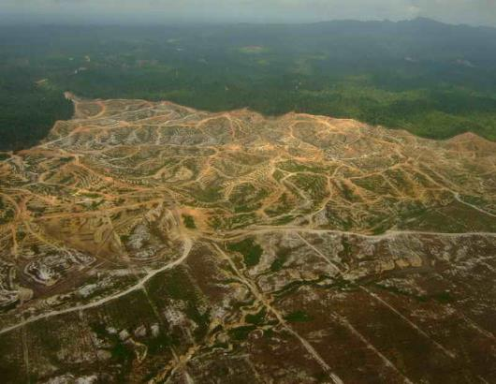
Ecological Impacts
Forest Loss.
Species Loss.
Water Depletion & Contamination
Soil Depletion, Erosion, Contamination

Slide 33
Climate Impacts

Slide 34
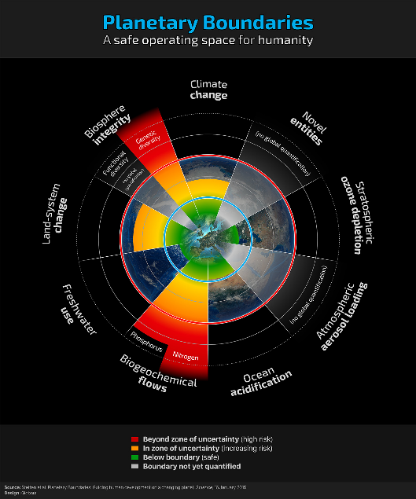
Planetary Boundaries Exceeded
Humanity has crossed four of nine ‘planetary boundaries’, increasing the risk of irreversibly driving the Earth in to a less hospitable state, concludes new research. These are: extinction rate, deforestation, atmospheric CO2 and the flow of nitrogen and phosphorus.
Notes:
scientists have identified a set of nine biophysical limits within which human life can exist safely on the planet, of which climate change is just one. The blue circle at the centre of the image shows the safety zone for each of these systems, while the orange and red pie-segments show how far we have already encroached on the acceptable limits.
Four of nine planetary boundaries have now been crossed as a result of human activity. […] The four are: climate change, loss of biosphere integrity, land-system change (for example deforestation), and altered biogeochemical cycles (phosphorus and nitrogen).
Crossing these boundaries increases the risks that human activities could suddenly push the Earth into a much less welcoming state, damaging efforts to reduce poverty and leading to a deterioration of human wellbeing in many parts of the world.
Will Steffen, Planetary Boundaries 2.0 – new and improved (2015) Stockholm Resilience Centre, http://www.stockholmresilience.org/21/research/research-news/1-15-2015-planetary-boundaries-2.0---new-and-improved.html Accessed February 2015.
Ibid.

Slide 35
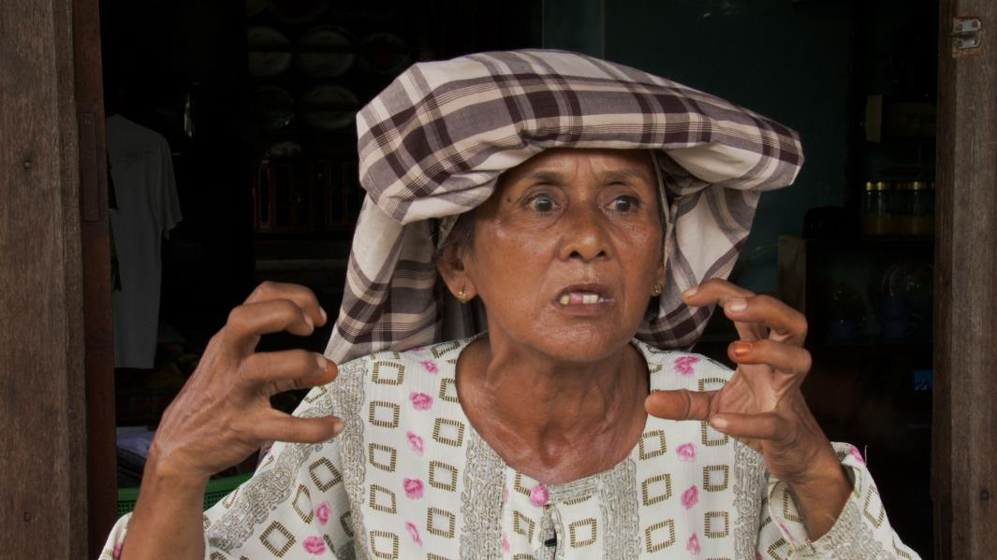
SOCIAL IMPACTS
Loss of Livelihoods, Loss of Food Security.
Disproportionate negative impacts on the poorest populations, especially on women.
Loss of languages and cultures (loss of human ways of being on the planet, loss of deeply rooted knowledge, loss of collective memory, and future resilience).
.
Notes:
Predicted extinction rates ranging from 50 to 90 % of the world’s some 7,000 languages by the end of this century.
Languages are a benchmark for cultural diversity because virtually every major aspect of human culture ranging from kinship classification to religion is dependent on language for its transmission.
Loss of language means a loss of traditional ecological knowledge (case of Palu Tsunami. Kaili elders have four key terms dealing with earthquakes three of which are topalu’e (the lifted soil), bombatalu (three strokes of the water cresting on soil), linu, the quake itself, and nalodo—“buried under mud,” which describes the ”liquefaction” that swallowed people and buildings whole during the quake.

Slide 36
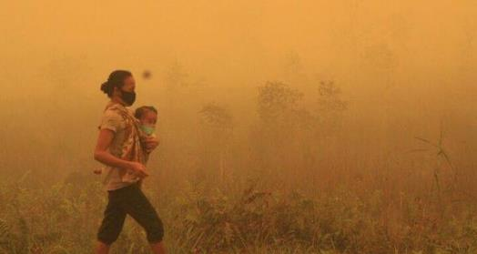
Health Impacts
Forest Fires.
But also from the loss of traditional knowledge on herbal medicines, and the loss of traditional medicines themselves through forest destruction.
Loss of clean water.

Slide 37
Violence
Tens of thousands land conflicts around the world.
More defenders of the land being killed around the world.
40% of those killed are indigenous people.

Slide 38
Who Benefits?
2019 world’s wealthiest 26 people own as much as poorest 50% of global population.
2017-18 new billionaire created every 2 days.
12 out of 20 wealthiest billionaires in Indonesia have their wealth from oil palm.
Notes:
thi

Slide 39
National / Local Extreme Events

Slide 40
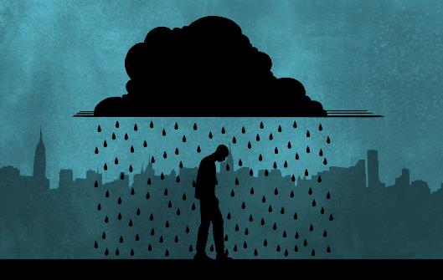
Obesity, Loneliness, Depression
Notes:
Remember the families from Nanga Taman in West Kalimantan?
They are either now dependent on day labourer jobs on the plantation, or have moved to the city. Poor, and dependent on palm oil for calorific intake.
Children eat unhealthy junk food and are becoming obese.
They are disconnected from place, culture, nature, elders – all of the ways that had been building resilience have been impacted.
Here in Scotland, in the US, and across wealthy countries we have a new health epidemic of obesity, loneliness and depression.
Scotland:
65% of adults over 16 overweight, 29% obese
26% children 2-15 overweight, 13% risk of obesity
Reasons are changes in diet and lifestyle
Junk food and food deserts
Stress – bad food choices and cortisol triggers fatty acids in abdomen
Drugs
Diabetes, high blood pressure, antihistamines (for allergies), steroids, antidepressants,
Link between Obesity and Loneliness:
Uni Cambridge found similar areas in genes which increase the likelihood of people being overweight also influence social isolation.
Tackling obesity would help to bring down loneliness.
Loneliness
lonely people are nearly twice as likely to die prematurely as those who do not suffer feelings of isolation
Feeling isolated from others can disrupt sleep, raise blood pressure, lower immunity, increase depression, lower overall subjective wellbeing and increase the stress hormone cortisol (at sustained high levels, cortisol gradually wears your body down).
Social isolation is as potent a cause of early death as smoking 15 cigarettes a day; loneliness, research suggests, is twice as deadly as obesity. Dementia, high blood pressure, alcoholism and accidents – all these, like depression, paranoia, anxiety and suicide, become more prevalent when connections are cut. We cannot cope alone.
Top 1% own 50% of global wealth but even they are not happy. It turns out those with a net worth of $75 million feel financially insecure, and need another 25% more monet.
This is what we are ripping our planet apart for.
Depression is also on the increase, and it all spirals back to worsening health, worsening inequality, unfulfilling jobs, worse environments, loneliness and obesity and the growing realisation that we face the most difficult circumstances in generations.

Slide 41
End Game?

Slide 42
What have we learnt?
World’s ecosystems under threat.
12 years to deal with climate change.
Indigenous Peoples are dealing with a constant extreme event - impacts on them are disastrous.
Systems for resilience are being destroyed.
The impacts of those who are supposedly beneficiaries of globalisation are not as expected.
But we are not addressing the issue because we think we are not directly affected, still less the ultra-rich.
We are heading towards psychological breakdown because of disconnection with nature, with others, with ourselves and with land.
Grisis Siknis…
Notes:
HOW ARE YOU ALL FEELING?
WETIKO NEXT

Slide 43
Seeing Wetiko
https://www.youtube.com/watch?v=ZBV9-YdxX0M

Slide 44
Behave like our house is on fire
Because it is. Greta Thunberg
Notes:
The problem is disconnection, and the removal of community control.
We cannot tackle the large-scale, but we can act immediately locally.
“I don't want your hope. I want you to panic. I want you to feel the fear I do. Every day. And want you to act. I want you to behave like our house is on fire. Because it is.” Greta Thunberg
But what happens when the house is on fire?
Have you ever been in an extreme event? What happened during the event? How did people react, act, organise?

Slide 45
Shock creates solutions
Cuba and Peak Oil
Hurricane Mitch
Argentina Economic Collapse
Bangladesh floating garden adapatation
Greece back to the land movements
Notes:
Cuba
How Cuba survived peak oil
This need to bring agriculture into the city began with the fall of the Soviet Union and the loss of more than 50 percent of Cuba’s oil imports, much of its food and 85 percent of its trade economy. Transportation halted, people went hungry and the average Cuban lost 30 pounds.
Special period, no more oil (imported crude oil in exchange for sugar cane at prices fixed in the 60s, had own refineries). Frequent black-outs, daily calorific intake down by 30%.
Cubans started to grow local organic produce out of necessity, developed bio-pesticides and bio-fertilizers as petrochemical substitutes, and incorporated more fruits and vegetables into their diets. Since they couldn’t fuel their aging cars, they walked, biked, rode buses, and carpooled.
an estimated 50 percent of Havana’s vegetables come from inside the city, while in other Cuban towns and cities urban gardens produce from 80 percent to more than 100 percent of what they need.
Permaculture, local crop and insect institutes. I worked alongside Cuban agronomist. Didn’t like not having petrochemicals but admitted it worked.
Mitch
People organised. They helped each other cross raging rivers. They provided shelters to families. They received support from solidarity networks built in the 80s.
Argentina
spontaneous emergence of barter markets
Community cooperatives also formed to provide the means for a higher level of local function and, thus, greater regional stability. During the collapse, both functioned together to create a culture of mutual cooperation, to decrease tensions and conflict and to safeguard the basic needs of every individual within the community. (buses, healthcare)
Community asset ownership – as workers took over companies that were going bust. – some 500 companies.

Slide 46
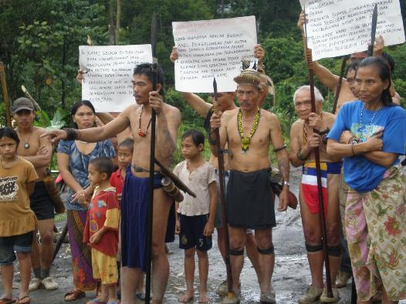
Maintain what is left
Indigenous communities still maintain 80% of cultural and biological diversity – support them!
Indigenous peoples are often the best protectors of their lands, resources and territories.
They need their rights protected.

Slide 47
Community rights => reduced emissions

Slide 48
Xingu territory, brazilian amazon
Notes:
Deforestation around the Xingu reserve, Brazilian Amazon, in 1994 (left) and 2007 (right)

Slide 49
Rebuild Resilience
Compassionate Frome
Recreate the connections to self, community, nature
Land Reform
Rebuild commons
Critical Awareness Raising
Youth leadership
Revive elderhood.
Reconnect to nature.
Rebuild Community
Notes:
What are your thoughts on this?
The growth of community land ownership in Scotland over the last 20 years has led, in communities now owning their lands, to a reversal in declining population numbers, a greater sense of control and security leading to more long-term thinking and planning, a deepening sense of identity and belonging, financial stability, increased investments, and job creation. Community land ownership can be challenging and takes time, but overall the experience in Scotland shows that it leads to material and psychological benefits and increased community resilience.
Rebuilding Commons:
1. Define clear group boundaries. 2. Match rules governing use of common goods to local needs and conditions. 3. Ensure that those affected by the rules can participate in modifying the rules. 4. Make sure the rule-making rights of community members are respected by outside authorities. 5. Develop a system, carried out by community members, for monitoring members’ behavior. 6. Use graduated sanctions for rule violators. 7. Provide accessible, low-cost means for dispute resolution.
Health Connections Mendip, compiled a service directory of care providers and volunteers from health centres, local charities and other groups to provide support to people with poor health. These services range from attending to someone’s physical and emotional needs to assisting with the shopping, walking the dog or helping someone attend a confidence-boosting activity such as the local choir.
While across the whole of Somerset emergency hospital admissions rose by 29% during the three years of the study, in Frome they fell by 17%.

Slide 50
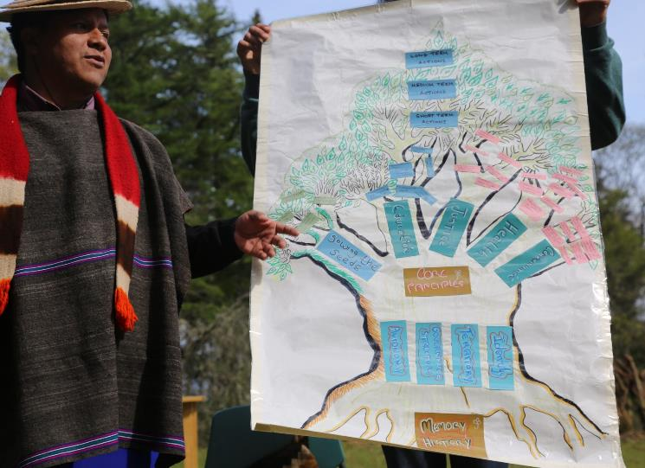
Plan de Vida
Notes:
We first encountered the Life Plan approach when working with the Kichwa of Sarayaku in Ecuador in 2010. Sarayaku’s Life Plan helped give the community strength and clarity to: stop oil development on their territory; support the emergence of many inspirational leaders serving in their territory and across the Ecuadorian indigenous peoples’ movement (despite Sarayaku only having 2000 inhabitants); revitalise and develop indigenous education and health systems; and develop an indigenous ecotourism business, airline, multi-media studio, and satellite internet café in the middle of the Amazon.
The Misak are an indigenous people from the Colombian Cauca who have successfully reclaimed their land, their collective future and their cultural identity against all odds. In doing so they developed the Plan de Vida or Life Plan, an exceptional approach to long-term visioning and planning that supports communities to take control of their futures.
During Spanish colonial rule, they were displaced from large parts of their territory, stripped of their ancestral land, with their culture and mother tongue threatened with extinction. The past fifty years of civil war in Colombia have meant the Misak have had to deal with perpetual conflict, with the army, paramilitary forces and guerrilla regularly passing through or fighting in their territory. Despite this background of violence, the Misak held steadfast to a constant practice of peace, reclaiming much of their ancestral territory from their colonial era landlords in the 1970s. To build on this success, in the 1980s they developed an approach to reclaim their self-determined futures - they called this approach the Plan de Vida, or Life Plan.
The Misak people of the Colombian Cauca have successfully reclaimed their land, their futures and their culture against all odds. In doing so, they have developed the 'Life Plan', an exceptional approach for communities to re-envision and take control of their futures. Pioneered by the Misak in the 1980s, the approach was later adopted by hundreds of indigenous peoples across South America.
The Life Plan process is based on learning from the past, critically analysing the present, and planning deep into the future. It is a long-term community-led process that aims towards self-determined community resilience and wellbeing. During this process, the Misak have gained formal recognition of rights over 15,000 hectares of their ancestral territory, they have revived their customary institutions, laws and leadership systems; protected and revived their knowledge systems and practices through developing indigenous education from preschool to university, and indigenous health including a Misak health clinic, women’s clinic, and laboratory to develop new plant-based preventative medicines; renegotiated relationships with the state including the relationship between customary law and national law; and helped bring about the 1991 constitution with better rights for indigenous peoples in Colombia.
The Life Plan and other such approaches to self-determined development are simultaneously: processes for revitalising knowledge systems and practices; opportunities for youth to take on key roles in their own territory as they help elders put the Life Plan into practice; detailed plans for managing indigenous territories; and platforms to advocate for and defend biocultural rights.
Approaches to self-determined development invite indigenous peoples to recognise themselves, to remember their collective history, and to determine their vision for the future. Such approaches have helped indigenous peoples protect their territories, restore their leadership and governance structures; and pursue their holistic vision in fields such as healthcare, land stewardship, sustainable livelihoods and education. Indigenous peoples with a clear vision for the future and strong governance over their territories are in a stronger position to exercise their right to FPIC, and to interact and negotiate with government and corporations planning developments on their territories.

Slide 51
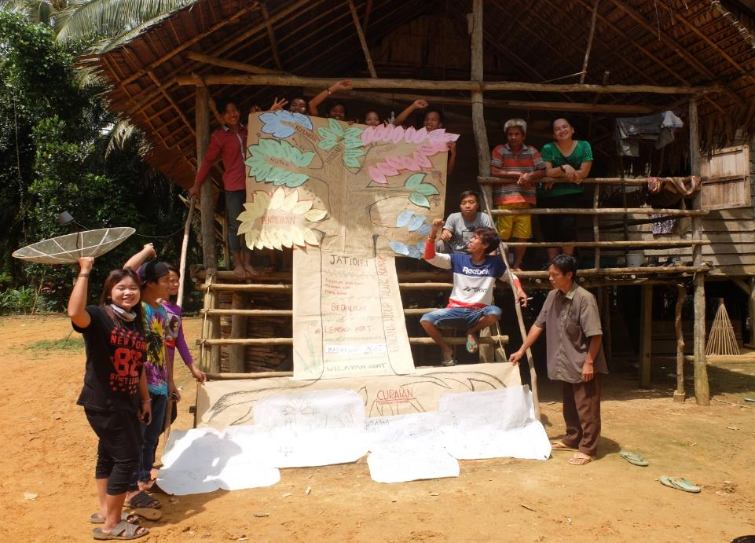

Slide 52
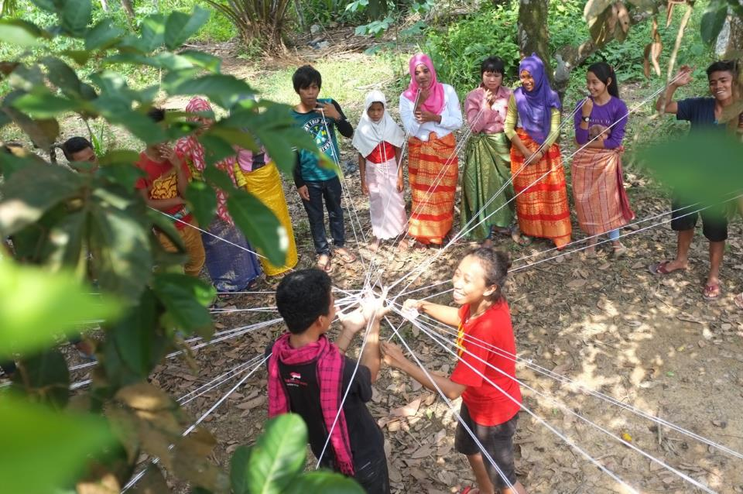
Notes:
Plan de Vida is an approach that at it's very heart ensures that it is rooted in teh history and culture of the community using it. “Frameworks are like toothbrushes: no one wants to use someone else’s.”
We know what the problems are. Disconnection, loss of power, loss of land, loss of community, loss of agency. And we know that the solutions are right there. We cannot easily tackle the immensity of the structures, that are stopping us from reacting in the way we should, but we can take immediate action at the level of community.

Slide 53
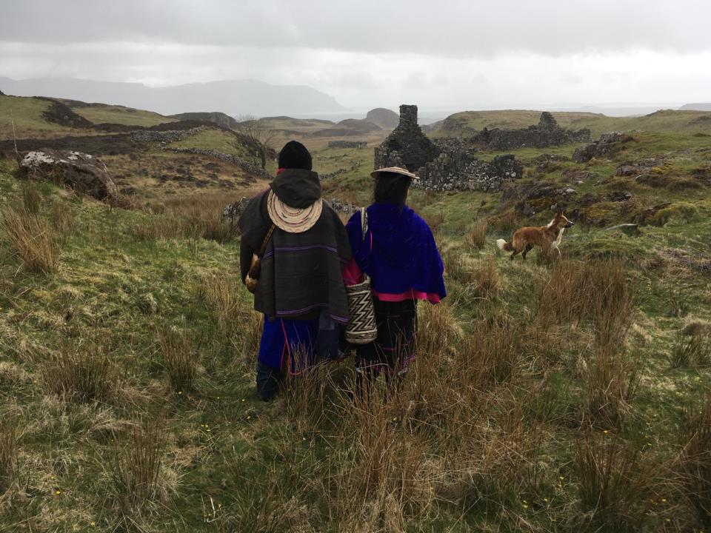

Slide 54
Keynote: Learning for Scotland
Group invited to add post-it notes/comments on the wall during lunch
Need to problematize indigeneity – view critically as indigenous ‘communities’ are not homogenous and not all good (negative tribalism, nationalism etc.)
We must not be shy to take back control (for our community, not in a Brexit sense)
Scotland in not unique, but does have issues/extremes our communities face that others may not

Slide 55
Session 2(a): Our own stories
Sharing anecdotal stories of how you / a community you know has been affected by extreme events
Examples:
Experience of dealing with fires, both as the responder and then impact on families and community

Slide 56
Session 2(b): What makes a community resilient in the face of extreme events? (8 groups)
Key features of resilient communities drawing from
Your own experience
Your knowledge (including research)
Thoughts from Serge’s keynote

Slide 57
Features of resilient communities – Clusters/Themes = colours. Summary from all 8 groups
Not listed in any particular order. 23-25 did not have group discussion
Social ties
Wider connections
Social connections
Connectivity
Experience and memory
Identity
Attachment to place
Shared identity and goals
Distributive shared leadership
Engagement
Shared responsibility on macro-level
Collective thinking promoting cultural change
Mindset
Openness to adapt
Integration across age, gender, culture etc.
Inclusivity and equity
Diversity – cultural and environmental
Communications
Coordination
Social support – emotional and practical between community members
Identifying local risks
Training and exercise
Dissemination of skills
Skills
Resources (people and money)

Slide 58
Session 2(c): What evidence do we have about the features of resilient communities?
In relation to the clustered features –
what do we know/what don’t we know,
What is the evidence
What is best practice
From Scotland/International
- Self-electing groups according to colour-coded clusters. Done twice, with people given opportunity to stay in group or explore others

Slide 59
Attendance at groups
Average attendance
Connections = 4.5
Memory = 11.5
Sharing = 6
Mindset = 3.5
Diversity = 5
Communication = 4
Training = 3.5

Slide 60
2(c): Social Ties and Wider Connections
What do we know?
Reflecting social movements at a local level
Learning about roots
Technological and non-technological experiences
Connected, but also in tension
Focus on internal or external social ties by themselves are not e.g. Chicago – internal ties but no ties to external structures (micro, miso, macro)
Forming social ties based on social capital, interests, cultures, locality (home, school/education, employment), sport, family, friends, use of space (community gardens, foodbanks, other shared experiences), language
Key people/relationships with communities – informal e.g. gossip, pub chat vs. formal e.g. local authorities
Scotland has lots of crossover with international experiences
Intergenerationality – fewer elders – role has been lost

Slide 61
2(c): Social Ties and Wider Connections
What don’t we know?
Tend to limit ourselves to human connections. What about disconnection from nature – ‘Cosmovision’.
What turns a locality into a community?
Which voices we are not hearing – who are “the community”?
We don’t always know what will work to facilitate increases social ties
Top down doesn’t always work, but people (government/policy-makers) want frameworks. But can we generalise?
Effects of extreme events on social ties – we have have assumptions that people bind together, but is there a difference between forced extreme evens (human-made) or natural events?
There is a disjuncture between health and social sectors, councils, academics and then communities
How to forge new types of community in post-industrial society?
Temporal longevity
Co-produced research – understanding how different groups understand ‘community’ - is it a ‘middle-class’ term?

Slide 62
2(c): Social Ties and Wider Connections
What is the evidence?
Research
Our own experiences - the lived experience
Evaluation of research outputs
Anecdotes
Witnessing communities ‘not working’
What is best practice?
Role of elders and ‘elderhood’ for ensuring space and power and connectivity
Embedding environmental education in schools in a meaningful way – not tokenistic.
Opening space for voices
Recognising language and communicating across different groups/spaces/genres/communities
Recognising and valuing indigenous knowledge
Co-creating/co-production – but need real co-production.
Getting to know people
Identifying ways of creating collective consciousness
Openness to feel

Slide 63
2(c): Experience and Shared Memory
What do we know?
Inclusive, shared identify of values and power
Geography/attachment to place – long-term vs recent, forward focused (sustainable), inclusive recovery
Communal spaces and symbols
Not about community, but rather a local social movement
What don’t we know?
Urban versus rural resilience
Temporality of resilience – requires long-term research to assess ongoing sustainability
Event recurrence – what happens?
Dynamics of establishing a shared narrative

Slide 64
2(c): Experience and Shared Memory
What is the evidence?
Research
Practice examples of recovery (positive and negative)
What is best practice?
Intangible, qualitative measures
Clear future plan, creation and celebration if identify
Learn from failure
State-locality relationship – empower ‘scaffold’
Communicate – place(s) – learning process, knowledge co-production

Slide 65
2(c): Leadership; Engagement; Shared Responsibility
What do we know?
Frameworks – SCEL, CLD, land buys
Government policy and guidance
What don’t we know?
Leadership can be a contested term – how do we define leaders and leadership?
Different definitions across specialism – so we all mean the same?

Slide 66
2(c): Leadership; Engagement; Shared Responsibility
What is the evidence?
Action plans
Emergency plans
Minutes from meetings
HGIOS
HGITSO
Other inspection documents
VSRP minutes held at Government level
Community Empowerment Act
Development Trusts
Communities using Right To Buy legislation
Asset transfers of building and lands
Tensions – geographic community v community of interest
Leadership in strategy documents and professional standards (HGIOTSO, HGIOS4, CLD standards)

Slide 67
2(c): Leadership; Engagement; Shared Responsibility
What is best practice?
Resources are provided e.g. flooding, snow, first aid kits, first aid training and resource mapping
Lists with info on vulnerable people
Insurance cover – public liability
Landlines
Training on different scenarios
Links with schools
Clear communication links
Uniformed Organisations (Scouts, Brownies, Girls/Boys Brigades etc.)
Social media used to communicate key messages
Recognising and promoting leadership at all levels
Promoting collaboration and community-led response
Local employment to address local issues i.e. social care
Visual cues to alert people to each other for support

Slide 68
2(c): Mindset; Collective Thinking; Openness to adapt; Cultural Change
What do we know?
Encourages - Openness to using technology
Encourages – Being listened to / opportunity to speak
Better systems are required to support behaviour change
Negative consequences of the speed or lack of cultural change to openness to adapt
Collective thinking by a powerful force not for good eg cult
What don’t we know?
New technologies and automation – how does this encourage a lack of resilience? i.e. loneliness and minimise our ability to respond
Don’t know what the catalysts are for such mindsets/collective thinking
Fear of controlled speech e.g. effect of snowflake society and being able to build resilience through open debate
Don’t know what resources/support is required helps collective thinking etc.
Reliance on Global economy – good or bad? Effect of convenience
Who is doing what? And what is working

Slide 69
2(c): Mindset; Collective Thinking; Openness to adapt; Cultural Change
What is the evidence?
Changing behaviours e.g. mooncup - Eco-Friendly Tampon & Pad Alternative
Community gardens e.g. Gorgie Road backgreen
Edinburgh Adapt, Transition Towns and Climate Ready Clyde
5p bag charge, reusable cup incentive (reduced price)
#MeToo – social movement that empowers change and voices
Responses of youth movement to America’s gun legislation
What is best practice?
Incentives
Communication to create a mindset eg. Good practice recycling flow chart
Taking away reliance on systems e.g. if council don’t cut the grass, will the community respond?
Plastics Movement inspired by Blue Planet – fashions and societal trends
Platforms for communication e.g. Borders messaging service – neighbourhood alert system

Slide 70
2(c): Integration, Inclusivity, Equity, Diversity
What do we know?
Definition of community – before very clear and related to site
Reduction of diversity within communities
Loss/Gain of inclusivity and equity
Loss of natural diversity and cultural heritage
What don’t we know?
Community definition now changing. What community means is different for different generations.
Fragmentation by class
New social movements
Virtual communities

Slide 71
2(c): Integration, Inclusivity, Equity, Diversity (natural and cultural)
What is the evidence?
Tension between communities – local and global
Tolerance
Value of difference and own identity
Low levels of biodiversity / ecosystem services
What is best practice?
Having value for difference and own identify
Knowledge exchange and open access to technology
Social movements
Proactive forms of participations
Proactive forms of driving change - integration

Slide 72
2(c): Communications; Social Support and Co-ordination
What do we know?
The more information given, the more cooperation received
Community spontaneous support needs to be coordinated
Resilience partnership plans for local problems
Social media – some people don’t trust it. Must come from known source. Some people don’t use it.
Two-way communications required
Physical and emotional support required
Database of resource
Require more “public information” films, apps, etc.
What don’t we know?
What is the best media?
If communications fails, how do we communicate?
How reliable are reports from the public? More calls = probably real
How to involve more people?

Slide 73
2(c): Communications; Social Support and Co-ordination
What is the evidence?
Resilience project involving the Third Sector
Resource register
Preparing Scotland
Resilience Direct
What is best practice?
Training
Exercising
Lessons learnt

Slide 74
2(c): Training and Exercise; Identifying Local Needs
What do we know?
Dependency on “The Centre” – knowledge and experience held centrally
What don’t we know?
Who has local knowledge and ownership of risks?
What is the evidence?
Need to use historical events
Knowledge of strengths and weaknesses
What is best practice?
Local plan to deal with threats - but who owns it and tests it is important
Need common approach to ensure standard approach (bench-marked)
Limited resources locally – may need to pool for large events

Slide 75
Session 3: What do we need to do to build on / share the evidence?
What are the knowledge / evidence gaps?
What connections are needed to share / build the evidence?
Who is missing?
Are there exemplars of good practice/greater insight from communities (for workshop 2)

Slide 76
1. What are the knowledge / evidence gaps?
Public awareness of what information exists and– the public don’t know what is available for them. NB Community Risk Register identifies top 10 risks for Scotland but not well promoted. There is a need for greater realisation by the public about addressing community resilience locally – but whilst structures may be in place many don’t want to be linked to statutory organisations /command and control approach to delivery.
Expectations of what others can provide - ‘Someone else’s job’ / lack of ownership
Lack of evidence about gender based violence – knowledge gap between theory and action
Limited knowledge about what happens to children/young people/ those with disabilities/ marginalised groups in disasters. There is some evidence but it is not well understood by policy makers
What do we gain? Lack of access to information and help
Gap between theory and practice
Evidence lacking for turning knowledge into action/change
Shared identity – Transferability? Core of resilience lies in shared identity, but we don’t understand what we share. It’s not a yes/no if something works, there is fluctuation and a range of impact, especially after events. Longitudinal evidence and research is need and a recognition that there is a temporal ebb and flow of community resilience

Slide 77
We don’t understand what turns a locality into a community – this comes and goes, fluctuates after an emergency. State intervention can divide a community. What happens after the cameras go home – need long term understanding. Process of negotiation and empowerment. It’s hard to evidence ‘what made it work’ and there is a lack of value in these processes too.
Transferability of best/good practice - note that what works well in one place doesn’t necessarily work elsewhere We often evaluate things/schemes rather than underpinning processes such as galvanisation. Nuancing and capturing what makes things work. The parts of the puzzle that drive change are often not valued – need to understand them more
What is the reality now? Extreme events are constantly happening. Lots of knowledge that comes together in events like this but so many people doing similar work and not linking.
Not clear how we build a movement.
Important to note the positive benefits of increasing community resilience

Slide 78
2. What connections are needed to share / build the evidence?
Importance of a shared vision and ownership will make any intervention/project more sustainable
What connections are needed to build and share?
Good example is Women for Independence and how that developed. Women for independence movement started out of the Scottish Independence movement - still going as a collective because have shared sense of ownership
All local authorities have structures in place to support community resilience. However, these structures seem to have little voice within them and people are not hearing about them.
Need balance between official system/structures and people’s voice. Sometimes people don’t want to connect if they don’t feel empowered.
Communities are not just geographical, how to connect between communities of interest and promote
Connections/connectivity – meta knowledge and meta belief - how do you change what people know about what other people think – shift in psychology – what influences behaviour isn’t so much what people think but what they think others think

Slide 79
2. What connections are needed to share / build the evidence?
Connectivity in communities is hidden and gendered. Women are supportive but often the support networks are informal, hidden and fragmented
Website, social media
Attitude that ‘it’s not going to happen to me’ is a barrier

Slide 80
3. Who is missing?
Funders
Community council reps
Emergency planning college
People from communities who have experienced extreme events
Community volunteers
Scottish Flood Form
Private sector
People who manage critical infrastructure

Slide 81
4. Are there exemplars of good practice/greater insight from communities (for workshop 2)
Scottish Flood Forum
Social Care in Aberdeenshire (Braemar shared care)
Refugee integration programme in Glasgow https://www.gla.ac.uk/research/az/gramnet/unesco/
NB can often learn more from bad practice where things have gone wrong or not worked as expected

Slide 82
Community Resilience to Extreme Events
19th February 2019
University of Stirling

